Slide 2


Slide 3
Hello, young lady.

Slide 4
What’s your name?

Slide 5
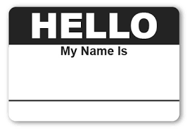
My name is Mike.

Slide 6

Where is the bathroom?

Slide 7
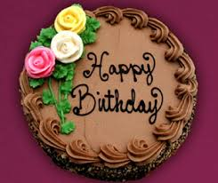
Happy Birthday!

Slide 8

What time is it?

Slide 9

I like the library.

Slide 10
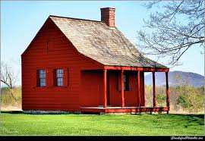
I live in the red house.

Slide 11
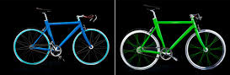
I have two bicycles.

Slide 12

Thank you very much and you’re welcome!

Slide 13
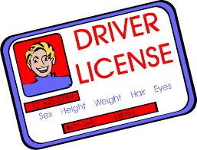
How old are you?

Slide 14
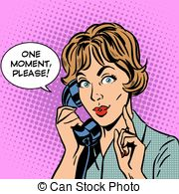
One moment, please.

Slide 15
It’s the
“One Semester of Spanish Spanish Love Song”

Slide 16
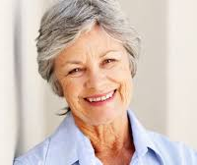
My mom is pretty.

Slide 17
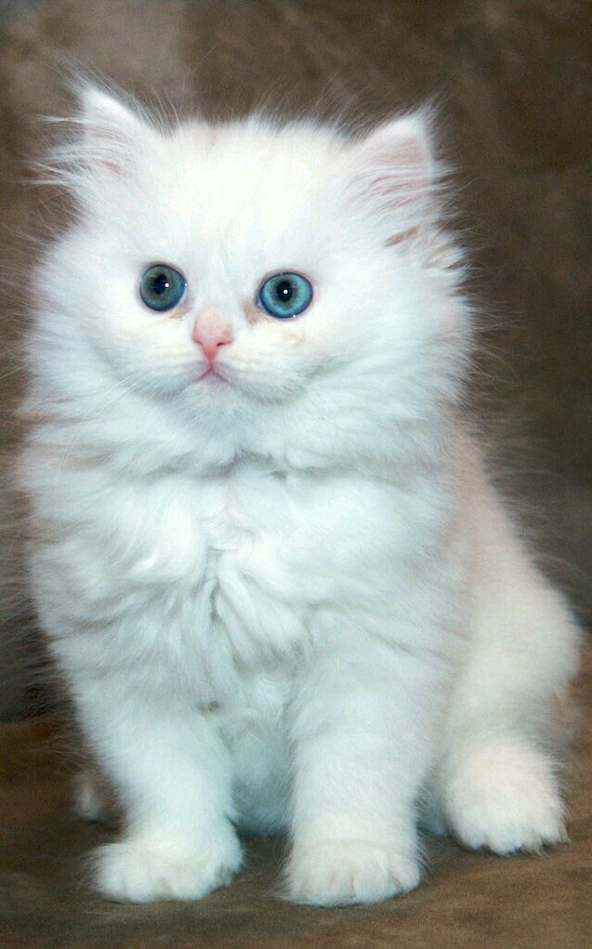
My cat is very white.

Slide 18

Forgive me. Forgive me!

Slide 19
1-2-3-4

Slide 20
5-6-7-8

Slide 21
9-10

Slide 22
11?

Slide 23
I don’t remember how to say 11.
11

Slide 24
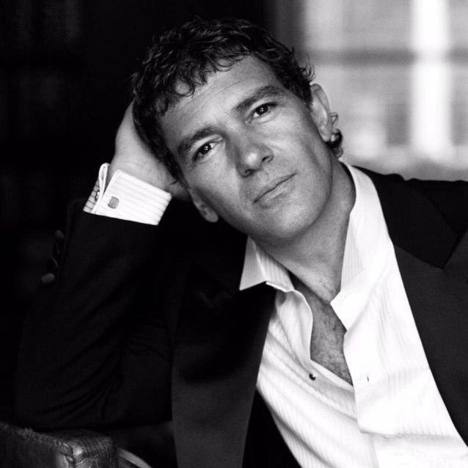
Antonio Banderes

Slide 25
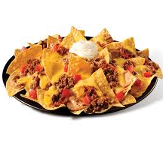
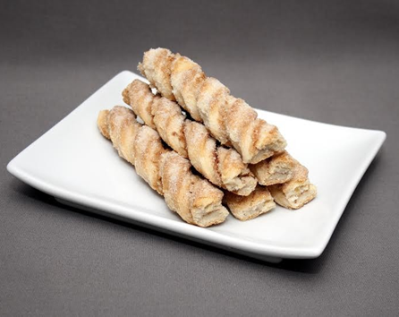
Large Nachos and Cinnamon Twists

Slide 26
It’s the
“One Semester of Spanish
Spanish Love Song”

Slide 27
Au revoir!
(French: means “goodbye”)

